Slide 1
QR CODE GENERATOR
PROJECT BY:
Gururaj P
Nikhil M

Slide 2
INTRODUCTION
A QR (quick response) code is a box-shaped matrix form of a 2-dimensional barcode (also called checkerboard-type barcode) that contains some meaningful data or linkage.
Such a code remains distributed on a 2D plane. It can hold numbers, English alphabets, Japanese letters, Chinese characters, special symbols (Unicode and ASCII), binary information, and other information within that square image. The corresponding appearance of dots (square dots or other shapes) represents binary "1", and the absence of these dots or white/blank spaces represents binary "0".

Slide 3
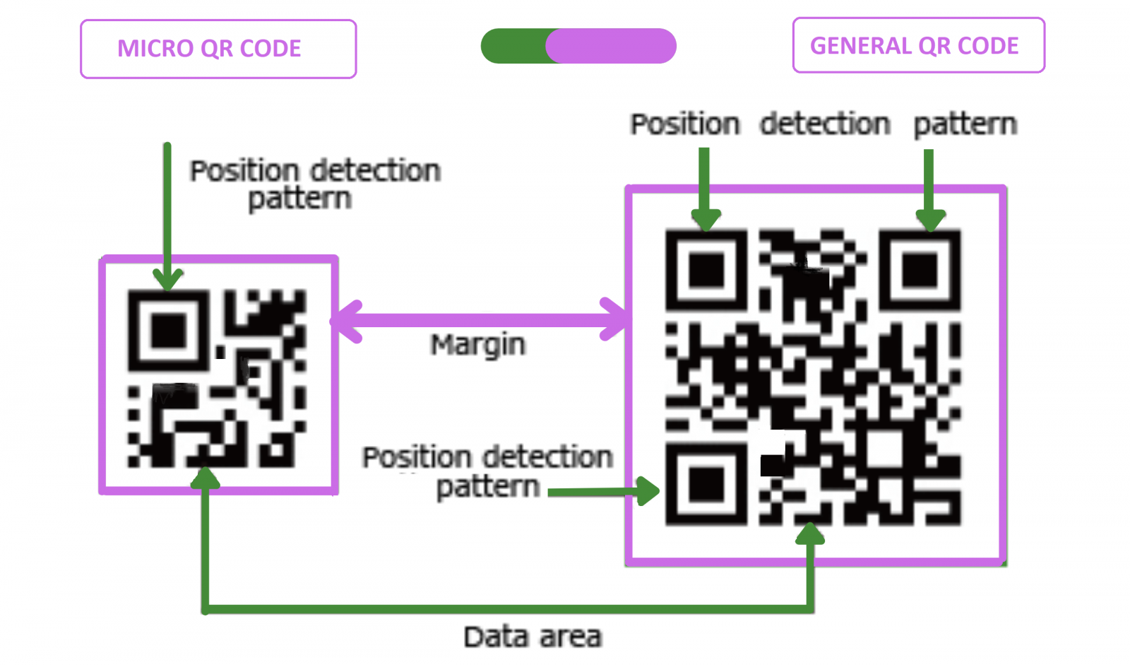
TYPES OF QR CODE 1.Micro QR code 2.General QR code

Slide 4
Steps to build the QR Code Generator in Python
1. Importing the modules
2. Creating the main window
3. Taking the input of the text/URL, location to store the QR code, name of the QR code and the size of the QR code
4. Writing the function to generate and save the QR Code

Slide 5
Source code
!pip install qrcode
import qrcode
data=“https://youtu.be/U_ug_srWqlw “ #copy n paste the link which you want to fit .
img=qrcode.make(data)
img.save(“Qrcode.jpg”)

Slide 6


